Slide 1
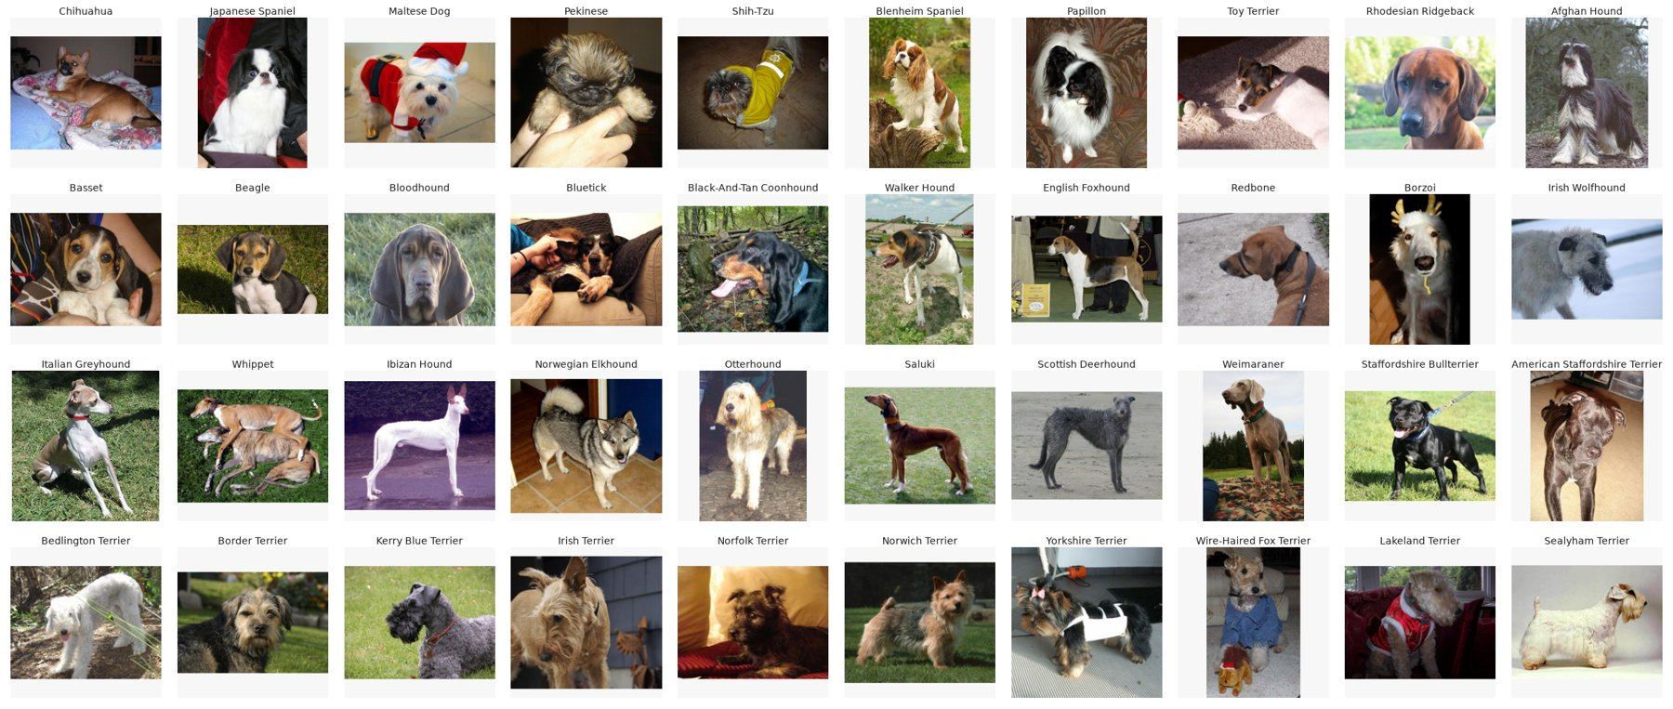
Dog Breed Classification on Stanford Dogs
ITRI626 Mini Project: Deep learning for image classification
Sulaiman Sulaman 45427429
Lindani Mdlalose 46290303
JP Retief 38279118
Notes:
Hello everyone, our project was about classifying dog breeds. The goal was to use transfer learning to train different models to classify dog breeds accurately.

Slide 2
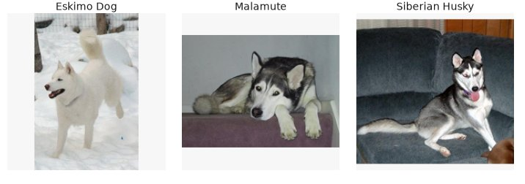
The Problem
Eskimo dog, malamute and Siberian husky
Classify a photo of a dog into one of 120 breeds
Fine-grained: some breeds look almost identical
Breed is often guessed by eye at shelters and vets
Aim: compare three model families and recommend one
2
Notes:
The problem here is that image classification network would have to deal with very subtle visual traits. As you can see the Eskimo Dog, Malamute and the Siberian Husky look alike in colour and size.
In practice, shelters and clinics would rely on subjective eye assessments, leading to misidentification.
For this project, each one of us trained models from separate families to assist the workers with the identifying dog breeds.

Slide 3
Dataset
Stanford Dogs (Khosla et al., 2011), via Kaggle
20,580 photos, 120 breeds
148 to 252 photos per breed
70/15/15 split, stratified, seed 42
Some image were duplicates – same image in different classes.
Reduced the breeds to 114 total, by merging some similar classes.
3
Notes:
We used Stanford Dogs, which contains over 20,500 images across 120 breeds, with a 70/15/15 stratified split to train, validate, and test.
Each class has about 150 to 250 images which is relatively small for deep learning.
When we checked the dataset, we discovered some images were duplicated over some classes. The models were first trained on the uncleaned dataset, and then on a cleaned dataset where the duplicates was removed by my discretion after viewing the classes and browsing the dog's typical features.

Slide 4
Models
Model | Family | Parameters | Pretrained
Custom CNN | VGG-style CNN | 4.6 M | No
MobileNetV3-Large | MobileNet (control) | 4.4 M | ImageNet-1K
EfficientNetV2-S | EfficientNet | 20.3 M | ImageNet-1K
Swin-T | Swin Transformer | 27.6 M | ImageNet-1K
MobileNetV3 is the same size as our CNN but pretrained, so comparing the two shows what pretraining alone is worth.
4
Notes:
We firstly trained a Custom CNN from scratch.
Then two beefy transfer learning architectures: EfficientNetV2-S and the Swin Transformer-T
And MobileNetV3-Large which is pretrained on ImageNet but is similar in size the custom CNN and therefore shows directly the benefit of transfer learning.

Slide 5
Transfer Learning and Setup
Transfer learning
Start from ImageNet-1K weights
Epochs 1–2: train only the new output layer
Epochs 3–5: unfreeze upper layers, lower learning rate (1e-5)
Setup
224×224 input; flips, small rotations, colour jitter
AdamW, batch 32, label smoothing 0.1
Custom CNN: up to 60 epochs, early stopping
Same split and metrics for every model
5
Notes:
So all three pretrained models start from ImageNet weights, and we train them in two phases.
Why two? Because that output layer is brand new and completely random. At the start it throws out big, messy gradients, and if the whole network were unfrozen those gradients would flow backwards and wreck the very features we're trying to borrow. So phase one, we freeze everything and train only that new layer. Once it's settled down, phase two, we unfreeze the upper layers and drop the learning rate right down to one e minus five. That's about thirty times lower. The pretrained features get nudged, not overwritten.
Now on the setup, the important bit isn't really the hyperparameters, it's what we kept identical. Same split, same input size, same augmentation, same metrics, every single model.
The one thing we did change is epochs. The pretrained models get five. Our custom CNN gets up to sixty. And that's deliberate. Fair doesn't mean everyone gets the same number of epochs. Fair means everyone gets enough to reach their own best, and a network starting from nothing needs a lot more passes to get there.

Slide 6
Results
Model | Accuracy | Top-5 | Macro F1
Swin-T | 88.0% | 99.3% | 0.875
EfficientNetV2-S | 83.1% | 97.8% | 0.825
MobileNetV3-Large | 67.5% | 91.8% | 0.671
Custom CNN | 53.8% | 84.8% | 0.532
Held-out test set, 3,200 photos
Pretraining alone (same size, MobileNetV3 vs our CNN) added 13.7 points.
6
Notes:
Right, top to bottom. Swin-T wins at 88 per cent. Our from-scratch CNN comes last at 53.8. So that's a 34 point gap.
Now the easy conclusion is that pretraining is worth 34 points. And that's wrong, and it's exactly why MobileNetV3 is sitting in this table. It's our control. It's actually slightly smaller than our own CNN, 4.4 million parameters against 4.6, but it's pretrained. And it gets 67.5.
So hold the size still, change only pretraining, and you get 13.7 points. That's about two fifths of the gap. The other 20.5? That's because EfficientNetV2 and Swin are also four to six times bigger, and they're newer designs on top of that.
And look at what it cost. MobileNetV3 got that 13.7 point lead in five epochs and 14 minutes. Our CNN took 59 epochs and over an hour to lose by that much.
One last thing, and it's my favourite number on this slide. Our CNN's top-1 is 53.8, but its top-5 is 84.8. So more than four times out of five it does get the right breed into its top five guesses, it just picks the wrong one of them. It isn't confused about what a dog looks like. It's confused between look-alikes.
If asked what the 20.5 points is: we can't separate size from architecture here. EfficientNetV2 and Swin are both bigger and newer than MobileNetV3, and splitting those two apart would need a size-matched comparison inside the pretrained group, which we didn't run.

Slide 7
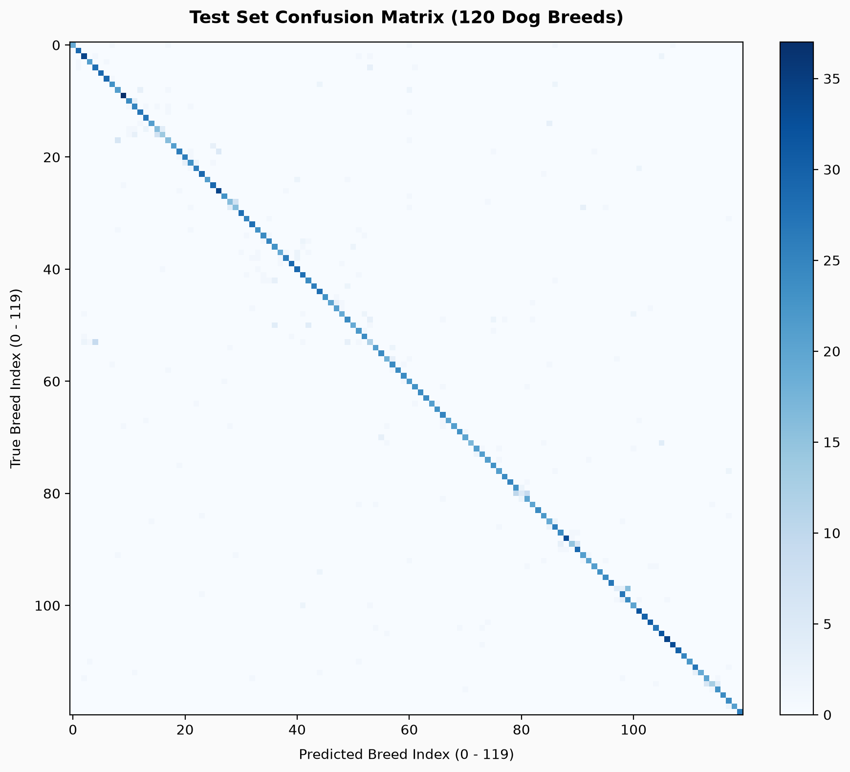
Confusion Matrix
7
Swin-T, all 120 breeds

Slide 8
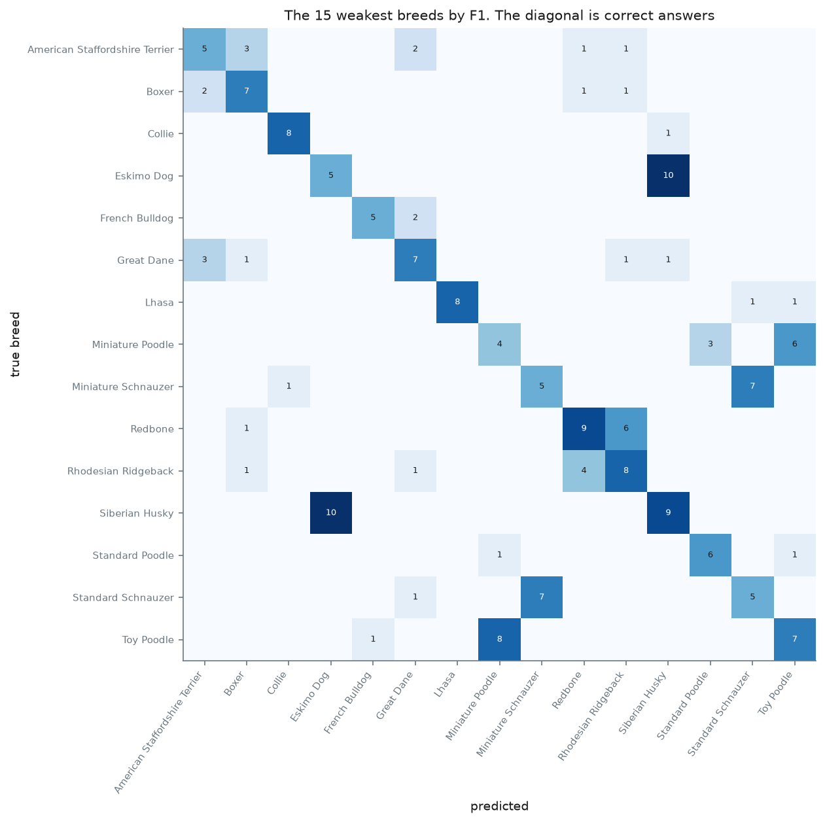
Confusion Matrix
Eskimo dog was predicted as husky 10 times
Toy and miniature poodles get mixed up
Both models struggle on the same breeds
7
Custom CNN, 15 weakest breeds

Slide 9
Limitations and Lessons Learned
Limitations
Each model was trained only once
Pretrained models only ran 5 epochs
Test photos may overlap with ImageNet
Wrong labels in the dataset cap accuracy
Lessons learned
Check the data before training
A same-size control makes comparisons fairer
Measure leakage if you can’t avoid it
Use one shared pipeline for all models
8

Slide 10
Conclusion
We recommend Swin-T: 88.0% accuracy and the best macro F1
EfficientNetV2-S is a good CNN alternative (about 5 points lower)
Pretraining made the biggest difference
Label errors in the dataset limit every model
Next step: test on an independently collected dataset
Thank you. Any questions?
9

